Slide 1

iOS Dev Camp #3 Week 6 Protocols, Delegate
Edward Chiang
2014.11.10 - 2014.11.14

Slide 2

Today
Protocols
Delegate

Slide 3
Protocols
5

Slide 4
Protocols
A class interface declares the methods and properties associated with that class.
A protocol, by contrast, is used to declare methods and properties that are independent of any specific class.
Protocols can include declarations for both instance methods and class methods, as well as properties.

Slide 5
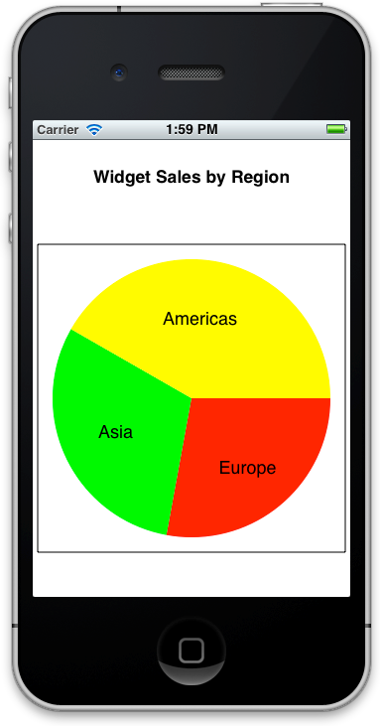
Protocols

Slide 6
Protocols
To make the view as reusable as possible, all decisions about the information should be left to another object, a data source. This means that multiple instances of the same view class could display different information just by communicating with different sources.
The minimum information needed by the pie chart view includes the number of segments, the relative size of each segment, and the title of each segment.
@protocol XYZPieChartViewDataSource
- (NSUInteger)numberOfSegments;
- (CGFloat)sizeOfSegmentAtIndex:(NSUInteger)segmentIndex;
- (NSString *)titleForSegmentAtIndex:(NSUInteger)segmentIndex;
@end

Slide 7
A Custom Pie Chart View
The pie chart view class interface would need a property to keep track of the data source object. This object could be of any class, so the basic property type will be id. The only thing that is known about the object is that it conforms to the relevant protocol.
Delegate and data source properties are usually marked as weak for the object graph management reasons described earlier, in Avoid Strong Reference Cycles.
@interface XYZPieChartView : UIView
@property (weak) id <XYZPieChartViewDataSource> dataSource;
...
@end

Slide 8
Protocols
To make the view as reusable as possible, all decisions about the information should be left to another object, a data source. This means that multiple instances of the same view class could display different information just by communicating with different sources.
The minimum information needed by the pie chart view includes the number of segments, the relative size of each segment, and the title of each segment.
@protocol XYZPieChartViewDataSource
- (NSUInteger)numberOfSegments;
- (CGFloat)sizeOfSegmentAtIndex:(NSUInteger)segmentIndex;
- (NSString *)titleForSegmentAtIndex:(NSUInteger)segmentIndex;
@end

Slide 9
Protocols Can Have Optional Methods
By default, all methods declared in a protocol are required methods. This means that any class that conforms to the protocol must implement those methods.
It’s also possible to specify optional methods in a protocol. These are methods that a class can implement only if it needs to.
@protocol XYZPieChartViewDataSource
- (NSUInteger)numberOfSegments;
- (CGFloat)sizeOfSegmentAtIndex:(NSUInteger)segmentIndex;
@optional
- (NSString *)titleForSegmentAtIndex:(NSUInteger)segmentIndex;
@end

Slide 10
Protocols
The @optional directive applies to any methods that follow it, either until the end of the protocol definition, or until another directive is encountered, such as @required.
@protocol XYZPieChartViewDataSource
- (NSUInteger)numberOfSegments;
- (CGFloat)sizeOfSegmentAtIndex:(NSUInteger)segmentIndex;
@optional
- (NSString *)titleForSegmentAtIndex:(NSUInteger)segmentIndex;
- (BOOL)shouldExplodeSegmentAtIndex:(NSUInteger)segmentIndex;
@required
- (UIColor *)colorForSegmentAtIndex:(NSUInteger)segmentIndex;
@end

Slide 11
Check that Optional Methods Are Implemented
If a method in a protocol is marked as optional, you must check whether an object implements that method before attempting to call it.
NSString *thisSegmentTitle;
if ([self.dataSource respondsToSelector:@selector(titleForSegmentAtIndex:)]) {
thisSegmentTitle = [self.dataSource titleForSegmentAtIndex:index];
}

Slide 12
Conforming to Protocols
@interface MyClass : NSObject <MyProtocol>
...
@end
Any instance of MyClass will respond not only to the methods declared specifically in the interface, but that MyClass also provides implementations for the required methods in MyProtocol.

Slide 13
~ END ~
http://www.alphacamp.tw

